Slide 1
L8 Autonomous Driving with IL&RL
Zonghua Gu 2022

Slide 2
Outline
Introduction to IL and IRL
Paper discussions

Slide 3
RL Reward Function Issues
RL can be very effective, provided that a suitable reward function is available.
Bad reward function leads to undesirable behavior
Suppose you design a vacuum cleaner to maximize reward function defined as “cumulative amount of dirt sucked in”. The vacuum cleaner may learn to repeatedly spit out and suck in the same pile of dirt!
For AD in realistic environment, the goal is to reach destination with minimum time, while avoiding accidents. But how to encode this into a reward function?
“A great reward function can help you better optimize your reinforcement learning model. In AWS DeepRacer, the reward function is written in Python code, and uses different input parameters to help encourage good behavior and disincentivize poor behavior. There’s no single right answer for which parameters to include in your reward function, and your best reward function will likely require a lot of experimentation.” from AWS DeepRacer MOOC
https://classroom.udacity.com/courses/ud014/
Notes:
State: Position of ego-car and environment (static and dynamic obstacles)
Action: Steering wheel/brake/accelerate

Slide 4
Imitation Learning (IL)
IL is useful when it is easier for an expert to demonstrate the desired behavior, rather than to specify a reward function for RL to learn the policy.
e.g., for Automated Driving in a realistic environment, the reward function would be a huge complex function involving everything in the environment
Requires access to an expert, either offline (driving data logs) or online (query-on-demand)
Also called Learning from Demonstrations.
IL variants:
Learn to mimic the expert’s policy
Behavior Cloning
Direct Policy Learning
Learn the expert’s value function
Inverse Reinforced Learning

Slide 5
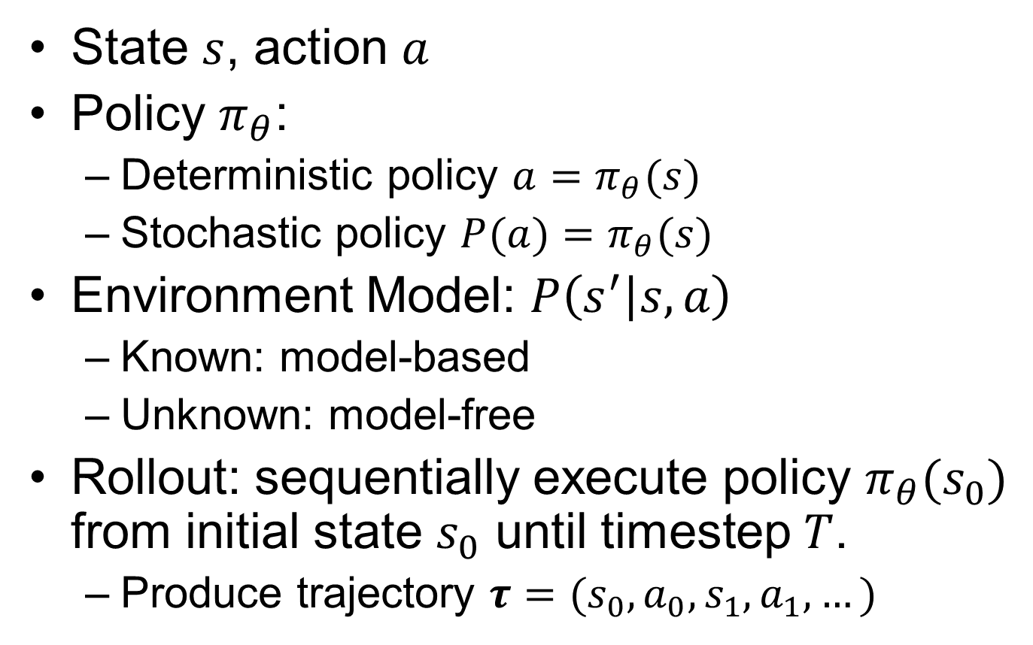
Review: Notations
State $s$, action $a$
Policy $π_{θ}$:
Deterministic policy $a=π_{θ}(s)$
Stochastic policy $P(a)=π_{θ}(s)$
Environment Model: $P\left(s^{′} | s,a\right)$
Known: model-based
Unknown: model-free
Rollout: sequentially execute policy $π_{θ}(s_{0})$ from initial state $s_{0}$ until timestep $T$.
Produce trajectory $τ=(s_{0},a_{0},s_{1},a_{1},…)$
Notes:
$P\left(τ | π\right)$: distribution of trajectories induced by a policy. Repeat until $t=T$:
1. Sample $s_{0}$ from $P_{0}$ (distribution over initial states), initialize $t=1$
2. Sample action $a_{t}$ from $π(s_{t−1})$
3. Sample next state $s_{t}$ from applying $a_{t}$ to $s_{t−1}$ (requires access to env model or simulator)
4. Go to Step 2 with $t=t+1$
$P\left(s | π\right)$: distribution of states induced by a policy (percentage of time spent in each state):
$$P\left(s | π\right)=\frac{1}{T}\sum_{t}{P_{t}\left(s | π\right)}$$
$P_{t}\left(s | π\right)$ denotes distribution of states at $t$-th timestep

Slide 6
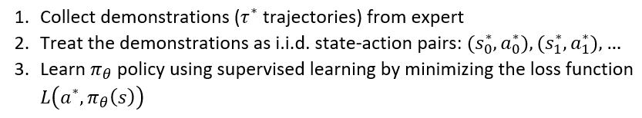
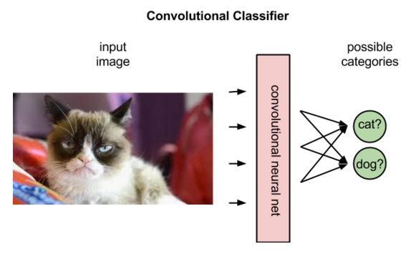
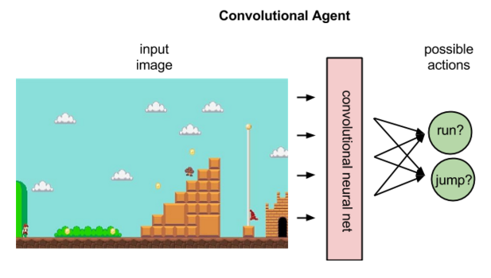
Behavior Cloning (BC)
Behavior Cloning (BC) is a form of Supervised Learning (SL), where an agent is trained to perform a task from demonstrations by learning a mapping (e.g., a CNN) between states (input data) and actions (labels).
https://pathmind.com/wiki/deep-reinforcement-learning

Slide 7
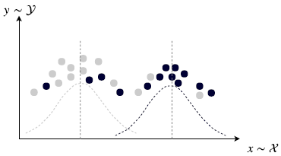
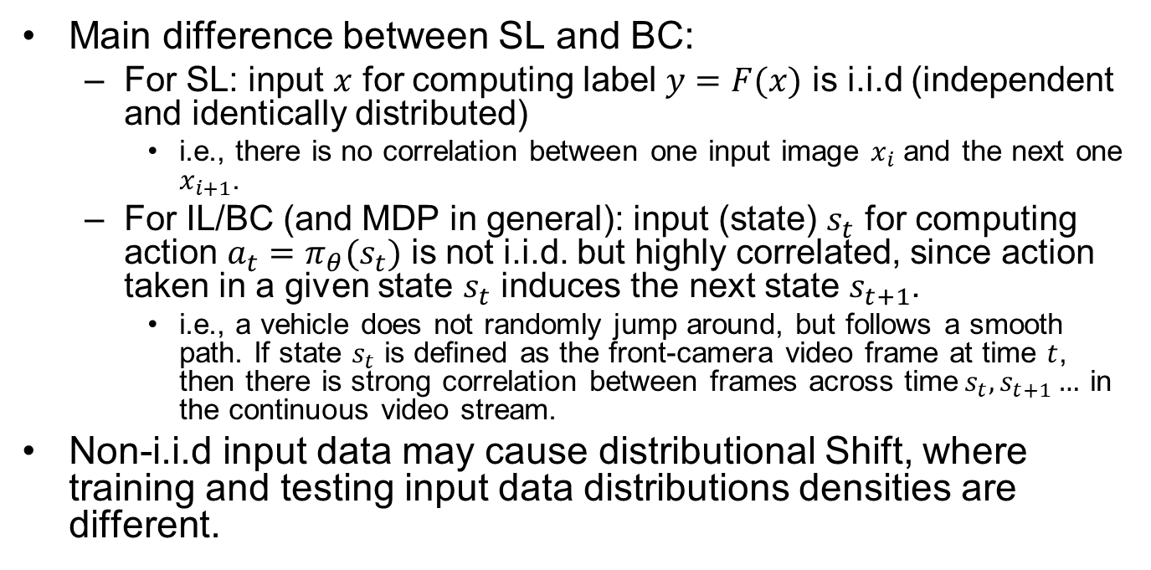
SL vs. BC
Main difference between SL and BC:
For SL: input $x$ for computing label $y=F(x)$ is i.i.d (independent and identically distributed)
i.e., there is no correlation between one input image $x_{i}$ and the next one $x_{i+1}$.
For IL/BC (and MDP in general): input (state) $s_{t}$ for computing action $a_{t}=π_{θ}(s_{t})$ is not i.i.d. but highly correlated, since action taken in a given state $s_{t}$ induces the next state $s_{t+1}$.
i.e., a vehicle does not randomly jump around, but follows a smooth path. If state $s_{t}$ is defined as the front-camera video frame at time $t$, then there is strong correlation between frames across time$s_{t},s_{t+1}…$ in the continuous video stream.
Non-i.i.d input data may cause distributional Shift, where training and testing input data distributions densities are different.
https://pathmind.com/wiki/deep-reinforcement-learning
Notes:
(sequence of state-action pairs)

Slide 8
Early Projects of IL (BC) Applied to AD
ALVINN
CMU, 1990
Low-res image as input
Fully connected NN
DAVE
Muller, LeCun, 2003
Low-res image as input
CNN
PilotNet

Slide 9
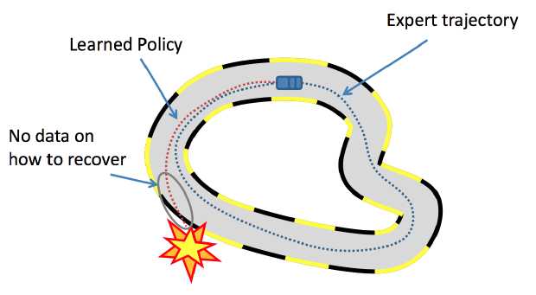
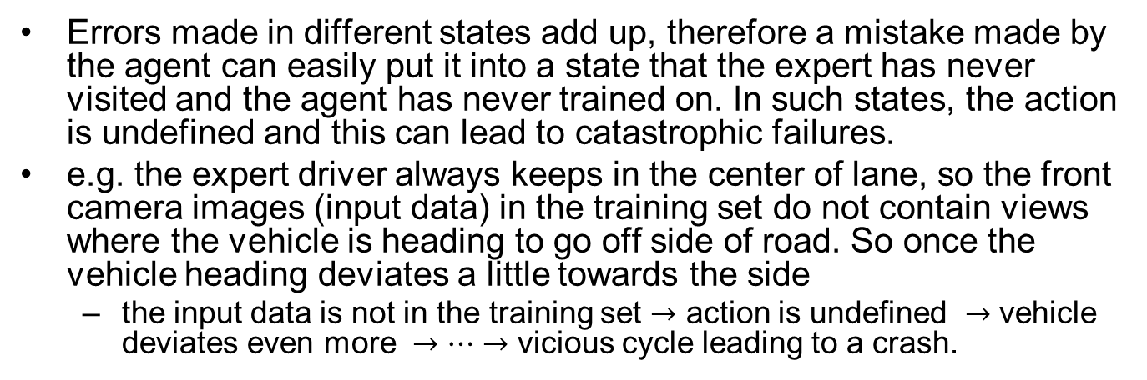
Distributional Shift in IL/BC
Errors made in different states add up, therefore a mistake made by the agent can easily put it into a state that the expert has never visited and the agent has never trained on. In such states, the action is undefined and this can lead to catastrophic failures.
e.g. the expert driver always keeps in the center of lane, so the front camera images (input data) in the training set do not contain views where the vehicle is heading to go off side of road. So once the vehicle heading deviates a little towards the side
the input data is not in the training set $→$ action is undefined $→$ vehicle deviates even more $→…→$ vicious cycle leading to a crash.
https://medium.com/@SmartLabAI/a-brief-overview-of-imitation-learning-8a8a75c44a9c

Slide 10
Inverse Reinforcement Learning (IRL)
Start with a set of expert’s demonstrations (we assume these are optimal) and then try to estimate the parameterized reward function, that would cause the expert’s behavior/policy.
Problem: reward function is not unique, multiple reward functions may lead to the same behavior.
e.g., an outside observer sees that you work very hard (behavior). He may infer your reward function to be “maximize WorkTime” (since you really enjoy your job). But your actual reward function is “maximize MoneyEarned” (while you really hate your job).
An agent with incorrect reward function won’t generalize well in a different environment. Suppose someone trains an agent to imitate you. The agent has the same behavior as you in the current environment, but faced with a job offer with higher salary, the agent may take a different action than you.
Solution: try to learn the correct reward function by observing the expert in diverse environments.

Slide 11
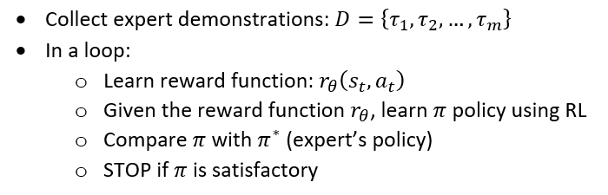
IRL Details
Repeat until we find a good enough policy:
Update the reward function parameters.
Solve the RL problem to find the optimal policy.
Compare the newly learned policy with the expert’s policy.

Slide 12
Outline
Introduction to IL and IRL
Paper discussions

Slide 13
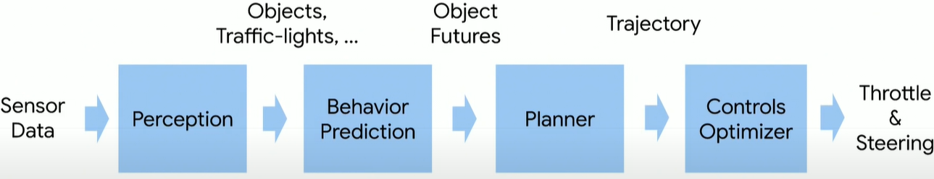
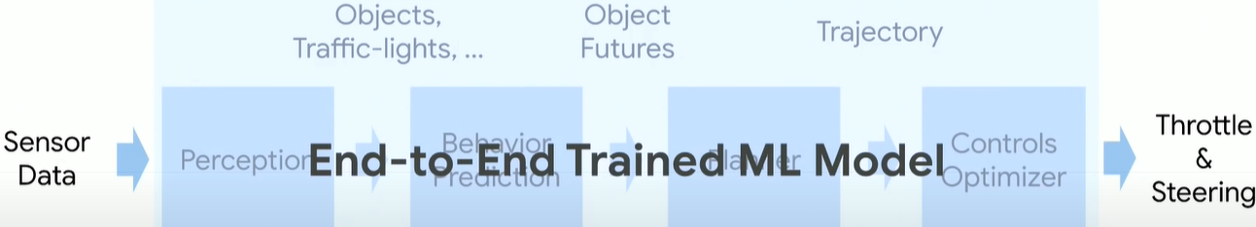
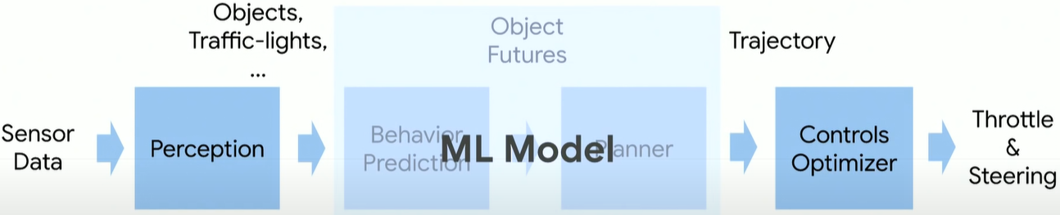
Classic Pipeline
End-to-End Driving (NVIDIA’s PilotNet)
Mid-to-Mid Driving (Waymo’s ChauffeurNet)

Slide 14
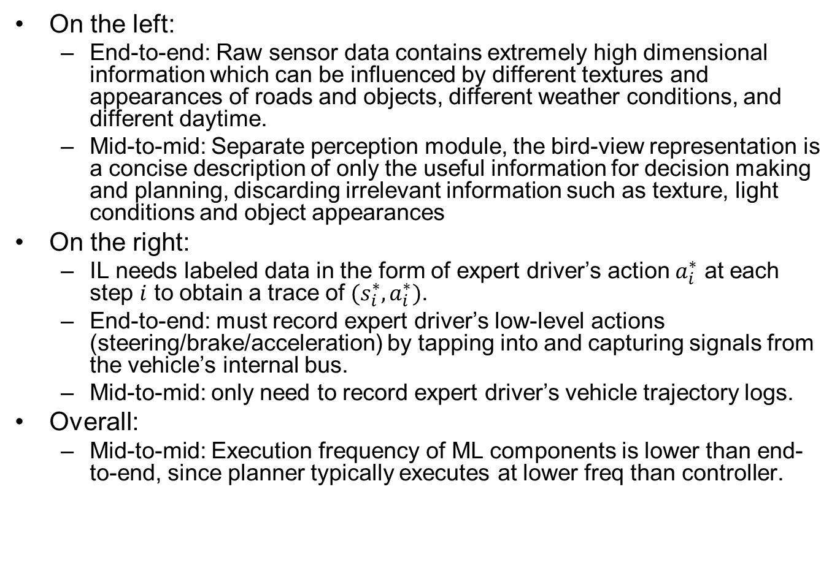
Advantages of Mid-to-Mid
On the left:
End-to-end: Raw sensor data contains extremely high dimensional information which can be influenced by different textures and appearances of roads and objects, different weather conditions, and different daytime.
Mid-to-mid: Separate perception module, the bird-view representation is a concise description of only the useful information for decision making and planning, discarding irrelevant information such as texture, light conditions and object appearances
On the right:
IL needs labeled data in the form of expert driver’s action $a_{i}^{∗}$ at each step $i$ to obtain a trace of $(s_{i}^{∗},a_{i}^{∗})$.
End-to-end: must record expert driver’s low-level actions (steering/brake/acceleration) by tapping into and capturing signals from the vehicle’s internal bus.
Mid-to-mid: only need to record expert driver’s vehicle trajectory logs.
Overall:
Mid-to-mid: Execution frequency of ML components is lower than end-to-end, since planner typically executes at lower freq than controller.
Notes:
generates bird-view representation, which helps simplify the visual information while maintaining useful information for driving.

Slide 15
[Zhou 2019]
Zhou, Brady, Philipp Krähenbühl, and Vladlen Koltun. "Does computer vision matter for action?." arXiv preprint arXiv:1905.12887 (2019). (Intel Labs, UT Austin)

Slide 16
Computer Vision vs. End-to-End
Computer vision tasks as perception module
Object recognition, depth estimation, optical flow, semantic segmentation…
e.g., train a model (CNN or others) with a large dataset to classify Stop Signs from images.
End-to-end approach
Map input images (raw pixels) directly to action, bypassing explicit computer vision tasks. Perceptual capabilities will arise as needed, as a result of training for the specific task.
e.g., if the training dataset is highway driving, then E2E model will never learn features of Stop Signs;
If the training dataset is urbane driving, then E2E model may learn features of Stop Signs implicitly in the intermediate layers of a CNN, during the process of learning the mapping from “Stop Sign” input images to “braking” action. But there is no explicit classification layer that outputs the label “StopSign”.
We report controlled experiments that assess whether specific vision capabilities are useful in mobile sensorimotor systems.
Does Computer Vision Matter for Action?
https://www.youtube.com/watch?v=4MfWa2yZ0Jc
Notes:
that act in complex 3D environments

Slide 17
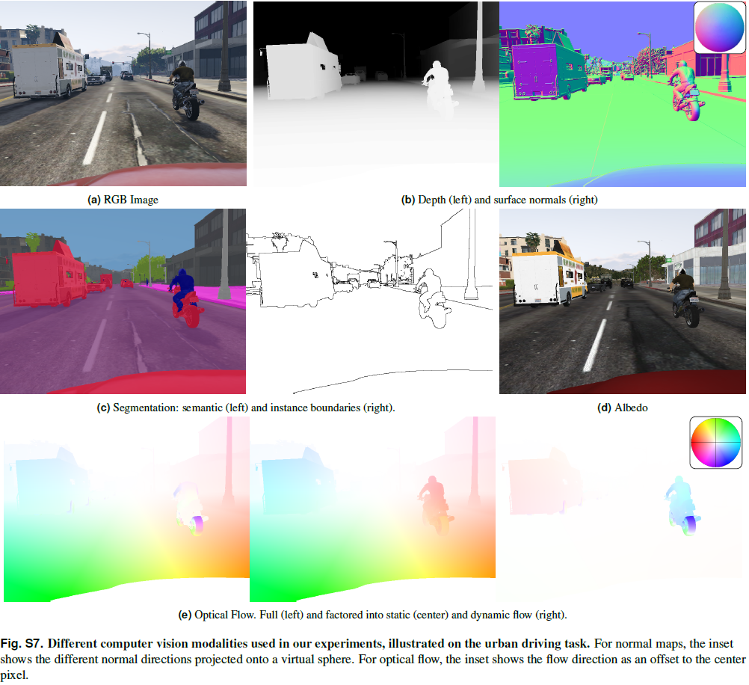

Slide 18
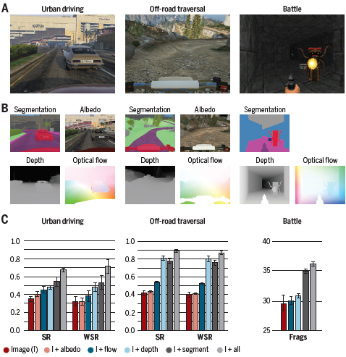
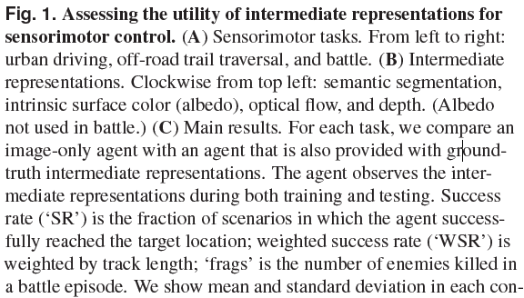
Performance Evaluation Results
Notes:
Surface albedo is defined as the ratio of radiosity to the irradiance (flux per unit area) received by a surface

Slide 19
Conclusions
Computer vision does matter.
When agents are provided with representations studied in computer vision, they achieve higher performance in sensorimotor tasks.
Some computer vision capabilities appear to be more impactful for mobile sensorimotor operation than others. Specifically, depth estimation and semantic segmentation provide the highest boost in task performance.
My thoughts: this explains rising popularity of mid-to-mid over end-to-end approaches.
Notes:
scene

Slide 20
PilotNet [Bojarski 2016]
Bojarski M, Del Testa D, Dworakowski D, et al. End to end learning for self-driving cars[J]. arXiv preprint arXiv:1604.07316, 2016.
End-to-End Driving (NVIDIA’s PilotNet)
Notes:
Bojarski M, Del Testa D, Dworakowski D, et al. End to end learning for self-driving cars[J]. arXiv preprint arXiv:1604.07316, 2016.
https://arxiv.org/abs/1604.07316

Slide 21
Training Method
End-to-End model trained with Imitation Learning (BC)
Human drives vehicle
Record sensor data and human actuator commands as training pairs
Train a DNN to map sensor data to actuator commands, mimicking a human. (PilotNet controls steering only. I think acceleration/braking are controlled separately, but the paper did not say how.)
PilotNet driving video:
https://www.youtube.com/watch?v=_N7nC-8YxzE
https://github.com/lhzlhz/PilotNet
Notes:
: End to End Learning for Self-Driving Cars

Slide 22
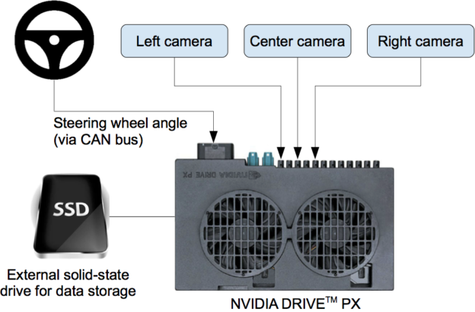
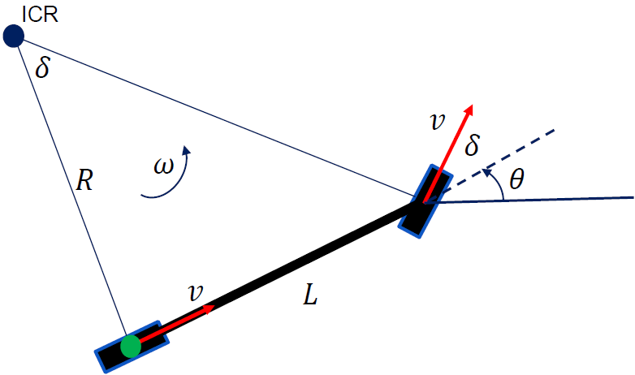
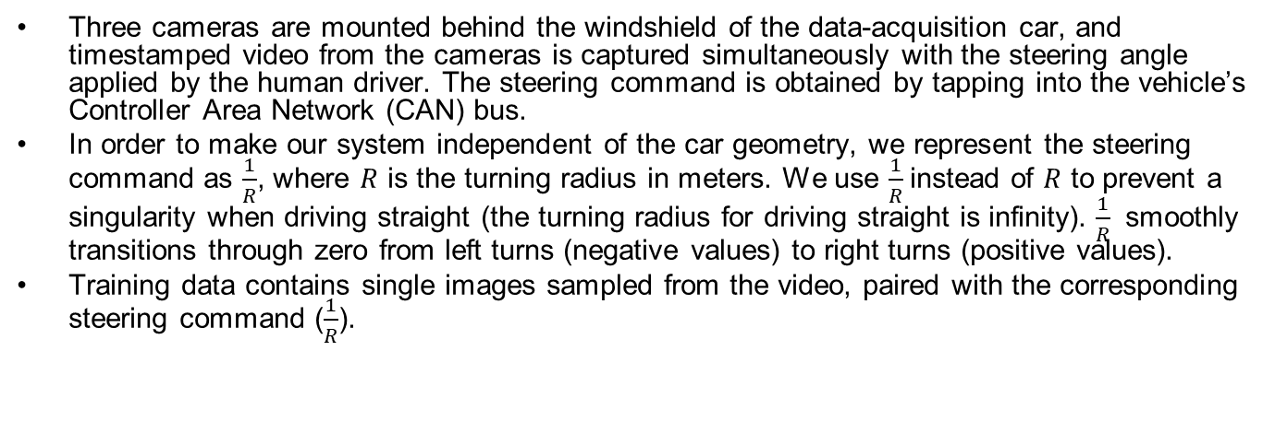


Data Collection System
Three cameras are mounted behind the windshield of the data-acquisition car, and timestamped video from the cameras is captured simultaneously with the steering angle applied by the human driver. The steering command is obtained by tapping into the vehicle’s Controller Area Network (CAN) bus.
In order to make our system independent of the car geometry, we represent the steering command as $\frac{1}{R}$, where $R$ is the turning radius in meters. We use $\frac{1}{R}$instead of $R$ to prevent a singularity when driving straight (the turning radius for driving straight is infinity). $\frac{1}{R}$ smoothly transitions through zero from left turns (negative values) to right turns (positive values).
Training data contains single images sampled from the video, paired with the corresponding steering command ($\frac{1}{R}$).
$$\frac{1}{R}=\frac{\tan{δ}}{L}$$
$$θ$$
https://devblogs.nvidia.com/deep-learning-self-driving-cars/

Slide 23
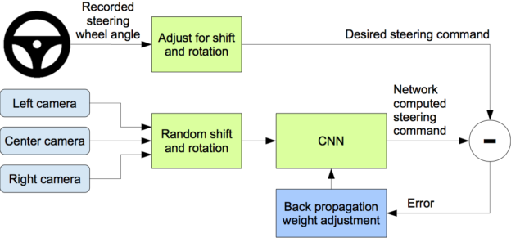
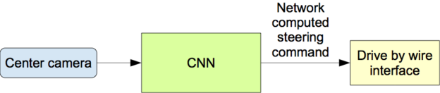
Training Data Augmentation
Problem: training data from human driver always stays in center of lane. So if car deviates from center, the image it sees is not in the training set, so it does not know the correct action.
Solution: Augment training data with additional images that show the car in different shifts from the center of the lane and rotations from the direction of the road. The images for two specific off-center shifts can be obtained from the left and the right cameras.
Training
Operation
Notes:
The training
data is therefore augmented with additional images that show the car in different shifts from the
center of the lane and rotations from the direction of the road.

Slide 24
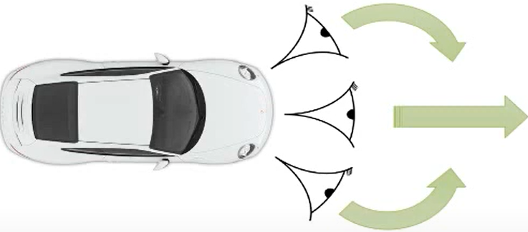
Training Data Augmentation Details
We augment the data by adding artificial shifts and rotations to teach the network how to recover from a poor position or orientation.
Images for two specific off-center shifts can be obtained from the left and the right camera. Additional shifts between the cameras and all rotations are simulated by viewpoint transformation of the image from the nearest camera. The steering label for transformed images is adjusted to one that would steer the vehicle back to the desired location and orientation in two seconds.
Ex.: Image from center camera shows car is driving straight; Shifted image from left camera shows car is leaning left. Associate this image with synthetic “turn right” command (even though human driver never issued it). During operation, if the center camera sees this image, issue “turn right” command.
Notes:
Precise viewpoint transformation requires 3D scene knowledge which we don’t have. We therefore approximate the transformation by assuming all points below
the horizon are on flat ground and all points above the horizon are infinitely far away. This works
fine for flat terrain but it introduces distortions for objects that stick above the ground, such as cars,
poles, trees, and buildings. Fortunately these distortions don’t pose a big problem for network training.

Slide 25
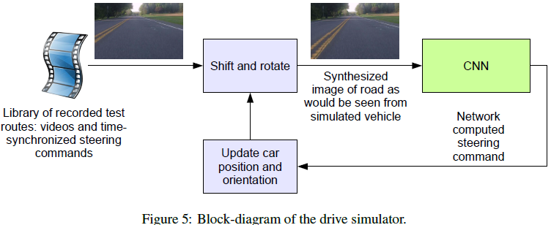
Driving Simulator
The simulator transforms the original images to account for departures from the ground truth. The magnitude of these perturbations is chosen randomly from a normal distribution.

Slide 26
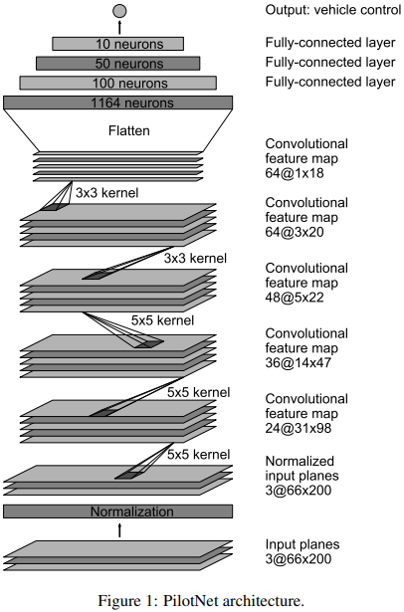
PilotNet
The network consists of 9 layers, including a normalization layer, 5 convolutional layers and 3 fully connected layers. The input image is split into YUV planes and passed to the network. The first layer of the network performs image normalization
Strided convolutions are used in the first three convolutional layers with a 2×2 stride and a 5×5 kernel and a non-strided convolution with a 3×3 kernel size in the last two convolutional layers.
The five convolutional layers are followed with three fully connected layers leading to an output control value that is the inverse turning radius

Slide 27
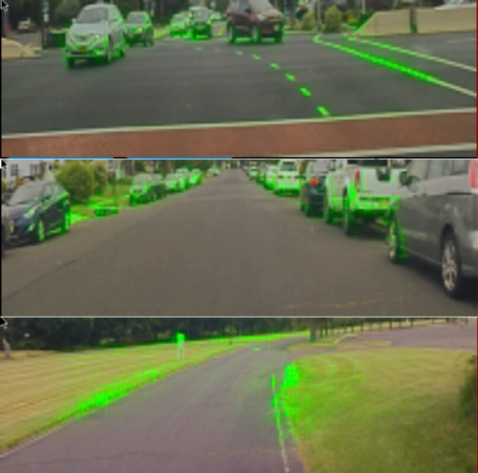
Visualization of Salient Objects
The visualization shows which regions of the input image contribute most to the output of the network. These regions identify the salient objects (highlighted in green).
PilotNet focuses on the same things a human driver would, including lane markers, road edges and other cars.
https://blogs.nvidia.com/blog/2017/04/27/how-nvidias-neural-net-makes-decisions/
Bojarski M, Yeres P, Choromanska A, et al. Explaining how a deep neural network trained with end-to-end learning steers a car[J]. arXiv preprint arXiv:1704.07911, 2017.
Notes:
Visualization, overlaid on an image of what the car’s camera recorded. Everything in green is a high priority focus point for the network.

Slide 28
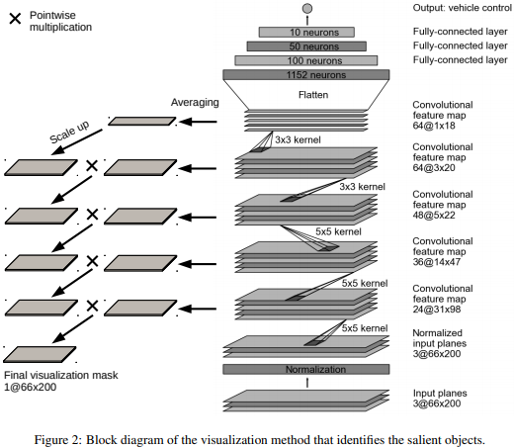
Visualization Method
Not covered in exam

Slide 29
On-Road Tests
After a trained network has demonstrated good performance in the simulator, the network is loaded on the DRIVE PX in our test car and taken out for a road test.
For a typical drive in Monmouth County NJ from our office in Holmdel to Atlantic Highlands, we are autonomous approximately 98% of the time. We also drove 10 miles on the Garden State Parkway (a multi-lane divided highway with on and off ramps) with zero intercepts.
Notes:
For these tests we measure performance
as the fraction of time during which the car performs autonomous steering. This time
excludes lane changes and turns from one road to another.

Slide 30
Chauffeurnet [Bansal 2018]
Bansal M, Krizhevsky A, Ogale A. Chauffeurnet: Learning to drive by imitating the best and synthesizing the worst[J]. arXiv preprint arXiv:1812.03079, 2018.
Mid-to-Mid Driving (Waymo’s ChauffeurNet)
https://medium.com/waymo/learning-to-drive-beyond-pure-imitation-465499f8bcb2
Notes:
Learning to Drive: Beyond Pure Imitation
Waymo Team, 2018 Bansal, Mayank, Alex Krizhevsky, and Abhijit Ogale. "Chauffeurnet: Learning to drive by imitating the best and synthesizing the worst." arXiv preprint arXiv:1812.03079 (2018). https://arxiv.org/pdf/1812.03079.pdf

Slide 31
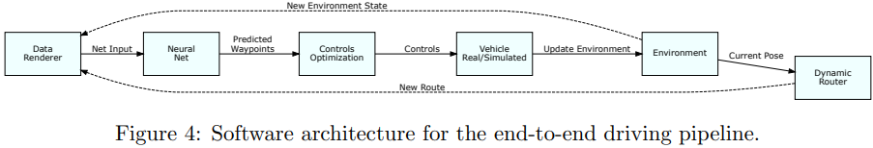
Abstract
Our goal is to train a policy for autonomous driving via imitation learning that is robust enough to drive a real vehicle. We find that standard behavior cloning is insufficient for handling complex driving scenarios, even when we leverage a perception system for preprocessing the input and a controller for executing the output on the car: 30 million examples are still not enough.
Training data: 30 million real-world expert driving examples, corresponding to about 60 days of continual driving
We propose exposing the learner to synthesized data in the form of perturbations to the expert’s driving, which creates interesting situations such as collisions and/or going off the road.
Rather than purely imitating all data, we augment the imitation loss with additional losses that penalize undesirable events and encourage progress – the perturbations then provide an important signal for these losses and lead to robustness of the learned model.

Slide 32
BC Experiments
Agent trained with pure BC gets stuck behind a parked vehicle (left) and is unable to recover from a trajectory deviation while driving along a curved road (right). The teal path depicts the input route, yellow box is a dynamic object in the scene, green box is the agent, blue dots are the agent’s past positions and green dots are the predicted future positions.

Slide 33
ChauffeurNet Experiments
ChauffeurNet model can now successfully nudge around the parked vehicle (left) and recover from the trajectory deviation to continue smoothly along the curved road (right).

Slide 34
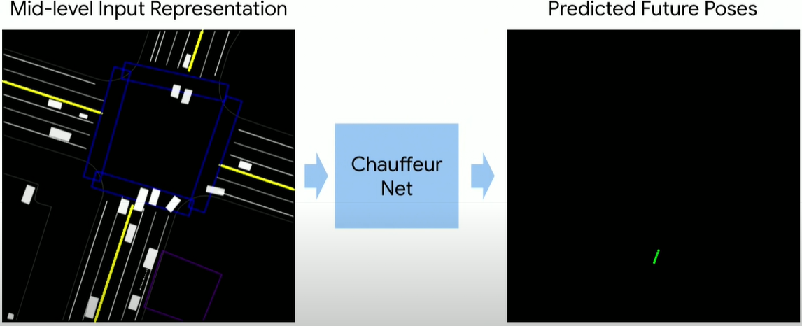
ChauffeurNet Input/Output
We use a perception system that processes raw sensor information and produces our input: a top-down representation of the environment and intended route, where objects such as vehicles are drawn as oriented 2D boxes along with a rendering of the road information and traffic light states. We present this mid-level input to a recurrent neural network (RNN), named ChauffeurNet, which then outputs a driving trajectory that is consumed by a controller which translates it to steering and acceleration.

Slide 35
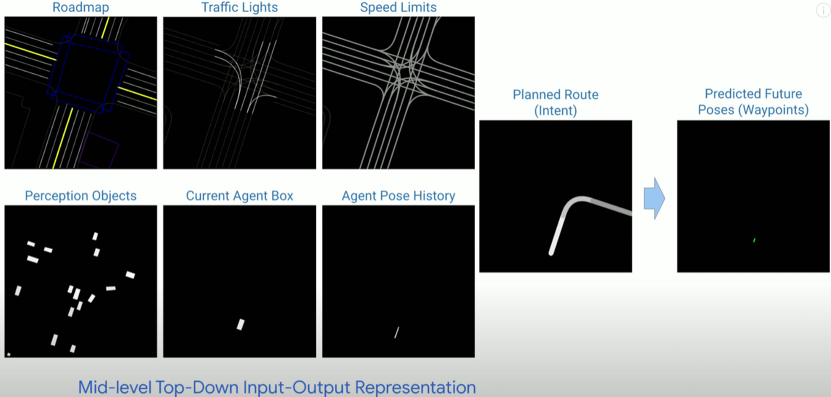
ChauffeurNet Input/Output in Detail

Slide 36
Rendered inputs and outputs
Output
Top-row left-to-right: Roadmap, Traffic lights (bright lines denote red light), Speed-limit, and Planned Route (intent: ego-car should turn right).
Bottom-row left-to-right: Current Agent Box, Dynamic Boxes (history of past 1-2s), Past Agent Poses, and the output Future Agent Poses (shown in last slide).

Slide 37
ChauffeurNet Architecture
ChauffeurNet is a Convolutional Recurrent Neural Network (RNN), consisting of the CNN FeatureNet, and the AgentRNN.
Trained with IL, guided by ground truth data (green) and loss functions (blue)
26M examples from real driving logs

Slide 38
Conditional IL (CIL) [Codevilla 2018]
Codevilla, Felipe, et al. "End-to-end driving via conditional imitation learning." 2018 IEEE International Conference on Robotics and Automation (ICRA). IEEE, 2018.

Slide 39
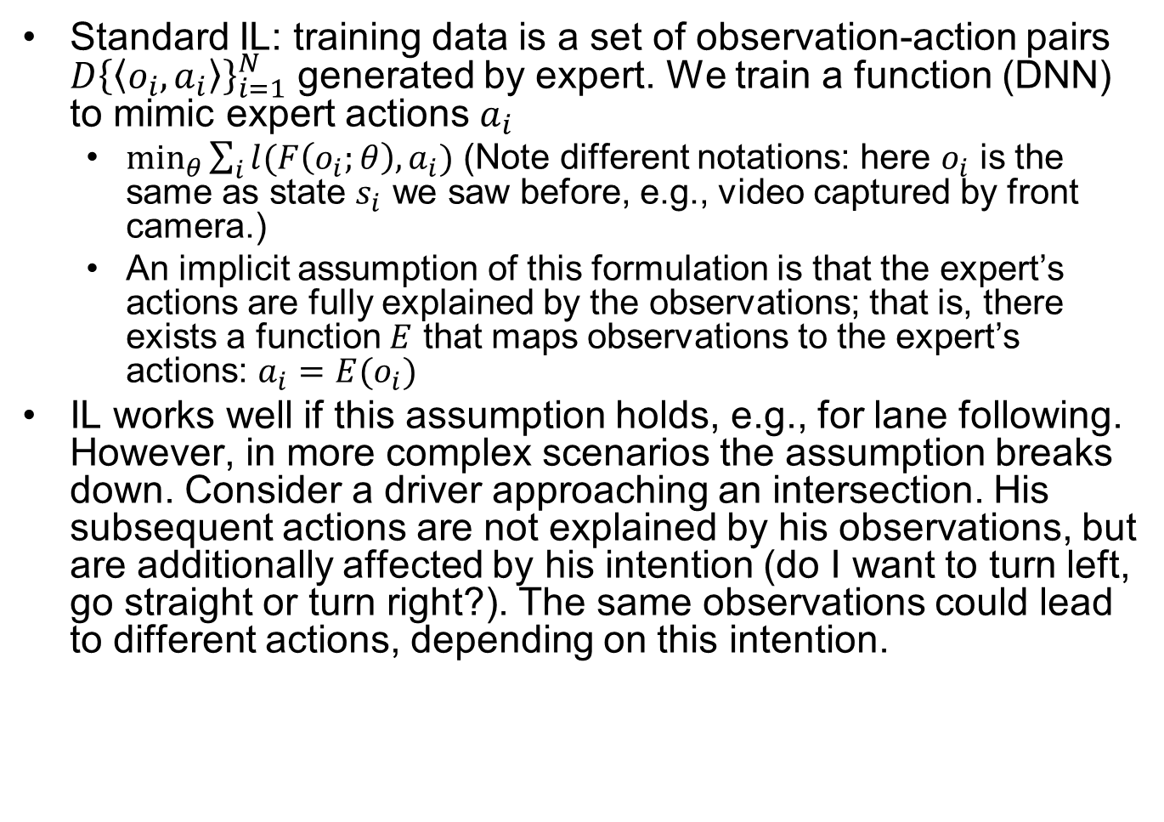
Standard IL Limitations
Standard IL: training data is a set of observation-action pairs $D{\left\{\left\langle o_{i},a_{i}\right\rangle \right\}}_{i=1}^{N}$ generated by expert. We train a function (DNN) to mimic expert actions $a_{i}$
$\min_{θ}{\sum_{i}{l(F\left(o_{i};θ\right),a_{i})}}$ (Note different notations: here $o_{i}$ is the same as state $s_{i}$ we saw before, e.g., video captured by front camera.)
An implicit assumption of this formulation is that the expert’s actions are fully explained by the observations; that is, there exists a function $E$ that maps observations to the expert’s actions: $a_{i}=E(o_{i})$
IL works well if this assumption holds, e.g., for lane following. However, in more complex scenarios the assumption breaks down. Consider a driver approaching an intersection. His subsequent actions are not explained by his observations, but are additionally affected by his intention (do I want to turn left, go straight or turn right?). The same observations could lead to different actions, depending on this intention.
Notes:
We first explicit model the expert’s internal state by a vector $h$, which together with the observation explains the expert’s action: $a_{i}=E(o_{i},h_{i})$. Vector $h$ can include information about the expert’s intentions, goals, and prior knowledge
$\min_{θ}{\sum_{i}{l(F\left(o_{i};θ\right),E(o_{i},h_{i}) )}}$

Slide 40
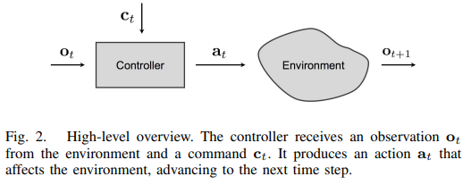
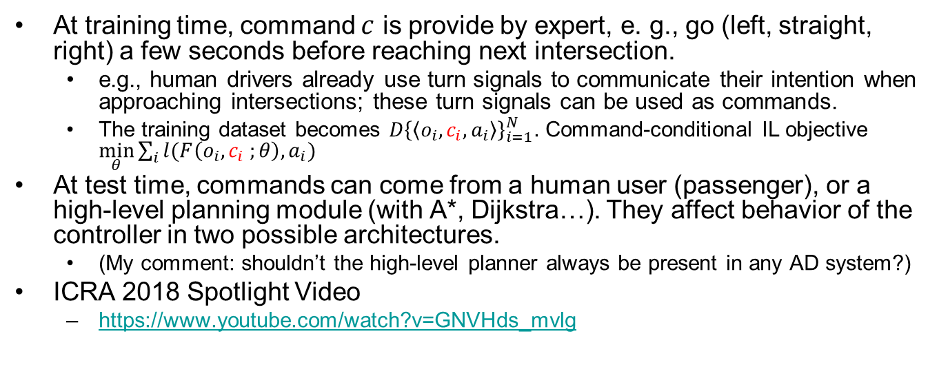
Command Conditional IL
At training time, command $c$ is provide by expert, e. g., go (left, straight, right) a few seconds before reaching next intersection.
e.g., human drivers already use turn signals to communicate their intention when approaching intersections; these turn signals can be used as commands.
The training dataset becomes $D{\left\{\left\langle o_{i},c_{i},a_{i}\right\rangle \right\}}_{i=1}^{N}$. Command-conditional IL objective $\min_{θ}{\sum_{i}{l(F\left(o_{i},c_{i} ;θ\right),a_{i})}}$
At test time, commands can come from a human user (passenger), or a high-level planning module (with A*, Dijkstra…). They affect behavior of the controller in two possible architectures.
(My comment: shouldn’t the high-level planner always be present in any AD system?)
ICRA 2018 Spotlight Video
https://www.youtube.com/watch?v=GNVHds_mvlg
Notes:
We expose the latent state $h$ to the controller by introducing an additional command input: $c = c\left(h\right)$ as an abstraction of
In urban driving, a typical command would be “turn right at the next intersection”, which can be provided by a navigation system or a passenger.
but if you rely on a human to give the condition, then it is not full AD; seems reasonable to rely on a high-level planning module to give condition or operator with remote control

Slide 41
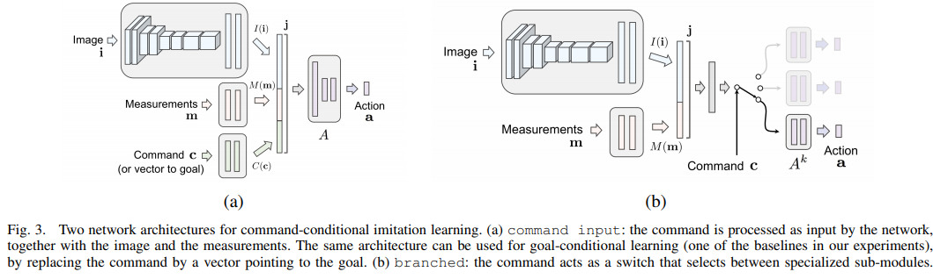
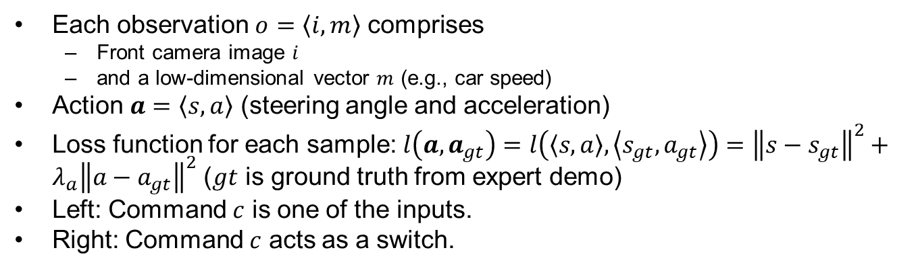
Two Architectures
Each observation $o=\left\langle i,m\right\rangle$ comprises
Front camera image $i$
and a low-dimensional vector $m$ (e.g., car speed)
Action $a=\left\langle s,a\right\rangle$ (steering angle and acceleration)
Loss function for each sample: $l\left(a,a_{gt}\right)=l\left(\left\langle s,a\right\rangle ,\left\langle s_{gt},a_{gt}\right\rangle \right)={\left\|s−s_{gt}\right\|}^{2}+λ_{a}{\left\|a−a_{gt}\right\|}^{2}$ ($gt$ is ground truth from expert demo)
Left: Command $c$ is one of the inputs.
Right: Command $c$ acts as a switch.
CNN
FCN (Fully Connected Network)
Notes:
Zgu: is the loss function correct? It minimizes deviation from the entire input trace, including both state and action. Or should it minimize deviation of action corresponding to each state?
Left: Controller F is a DNN that takes the image $i$, the measurements $m$, and the command $c$ as inputs, and produces an action $a$ as its output. The action space is continuous and two-dimensional: steering angle and acceleration.
Right:
Is this loss function true for any IL?

Slide 42
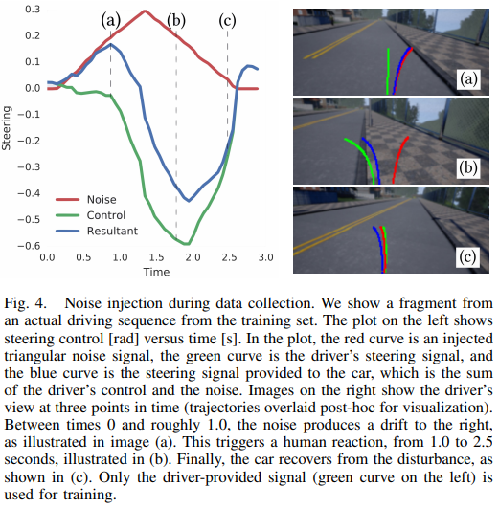
Data Augmentation

Slide 43
Comparisons
View representation:
PilotNet and CIL [Codevilla18] use front camera view
ChauffeurNet uses bird-view representation, which helps simplify the visual information while maintaining useful information for driving.
Where DNN is used:
PilotNet and CIL are end-to-end.
ChauffeurNet is mid-to-mid (DNN used for behavior prediction and planning to generate trajectory).
DNN Architecture
Compare to PilotNet
PilotNet uses CNN to map from current camera image to steering angle, no history info is used.
ChauffeurNet uses RNN, and exploits the history (past agent location and past prediction for a few seconds) to make better predictions and decisions.
CIL: adds a condition variable to help with the decision process at intersections.
Notes:
I find it strange, as you can input a past history of N frames to capture recent history
PilotNet and CIL use CNN, input is current video frame only, with no history info.
ChauffeurNet uses Convolutional RNN with an explicit memory, taking into account recent history.

